Slide 1

MINI PROJECT BE 3-SEM
Project Name: Real-Time Face Mask Detector
K.Sai Venkat 1602-20-733-101
K.Upendra 1602-20-733-116

Slide 2
Introduction
In this project we have used OpenCV, Keras, and Deep Learning. We introduce a mask face detection model that is based on computer vision. The proposed model can be integrated with surveillance cameras to impede the COVID-19 transmission by allowing the detection of people who are wearing masks not wearing face masks. The model is integration between deep learning and classical machine learning techniques with opencv, tensor flow and keras.

Slide 3
Objectives
In this project we created a COVID-19 face mask detector using OpenCV, Keras and Deep Learning.
To create our face mask detector, we trained a two-class model of people wearing masks and people not wearing maks.
We fine-tuned MobileNetV2 on our mask/no mask dataset and obtained a classifier that is ~99% accurate.
We then took this mask classifier and applied it to images by:
Detecting face in images.
Extracting each individual face
Applying our face mask classifier.
Our face mask detector is accurate, and since we used the MobileNetV2 architecture, it’s also computationally efficient.

Slide 4
Tools and Technology Used
Python: Python is an interpreted, high-level and general purpose programming language.
Keras: Keras is an open-source library that provides a Python interface for artificial neutral networks.
Tensorflow: Tensorflow is a free and open-source library for machine learning.
Deep learning: Deep learning is an AI function that mimics the workings of the human brain in processing data for use in detecting objects, recognizing speech, translating languages, and making decisions.

Slide 5
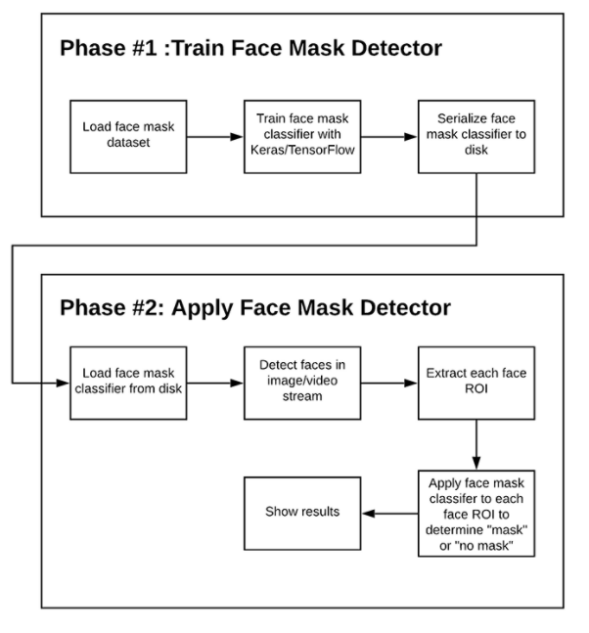
Implementation:
Two phase COVID-19 face mask detector

Slide 6
Requirements
Hardware Requirements
1 GB RAM
2 GB HDD
CORE i5
Software Requirements
Windows XP/ Windows 7 or later
PYTHON INTERPRETER

Slide 7
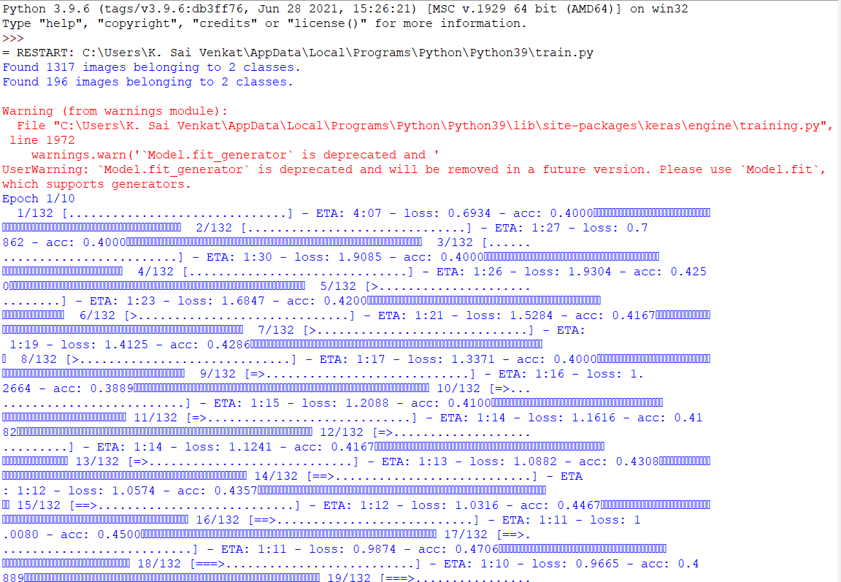
Results/Screenshots
FIGURE 1.1 PART-1 IMPLEMENTATION

Slide 8
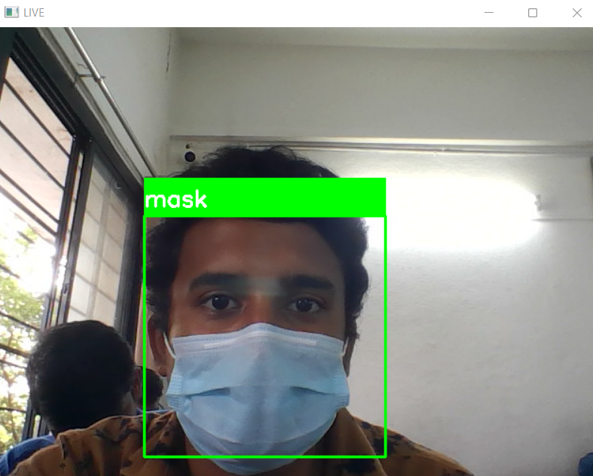
Contd….
FIGURE 1.2 PART-2 IMPLEMENTATION WITH MASK

Slide 9
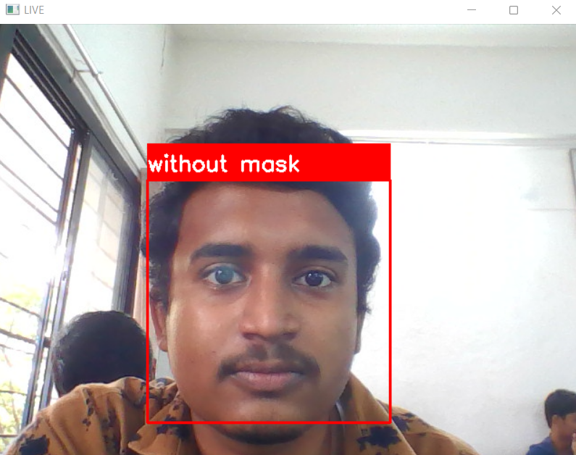
Contd….
FIGURE 1.3 PART-3 IMPLEMENTATION WITHOUT MASK

Slide 10
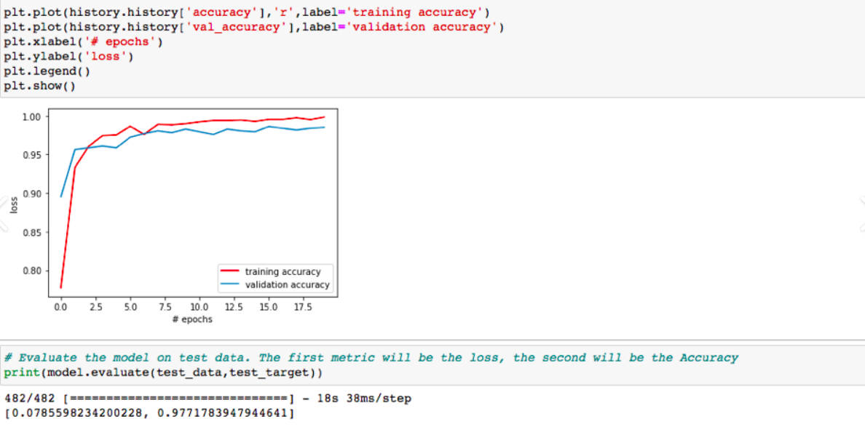
Contd...
Our model gave 99% accuracy for Face Mask Detection after training through Tensorflow – gpu==2.0.0

Slide 11
Future Work
The future perspective of this project is to detect whether a person in a public place is wearing a mask or not so that it will help to reduce this deadly virus.
References
DataFlair – Real – Time Face Mask Detector Using Python
Great Learning – Beginning Model Development with Python Using OpenCV

Slide 12
Conclusion
In this project, we had created a face mask detector using OpenCV, Keras/TensorFlow, and Deep Learning.
To create face mask detector, we trained a two-class model of people wearing masks and people not wearing masks.
We fine-tuned MobileNetV2 on our mask/no mask dataset and obtained a classifier that is ~99% accurate.
We then took this face mask classifier and applied it to both images by:
Detecting faces in images
Extracting each individual face
Applying our face mask classifier.

Slide 13
Thank you

